Slide 1
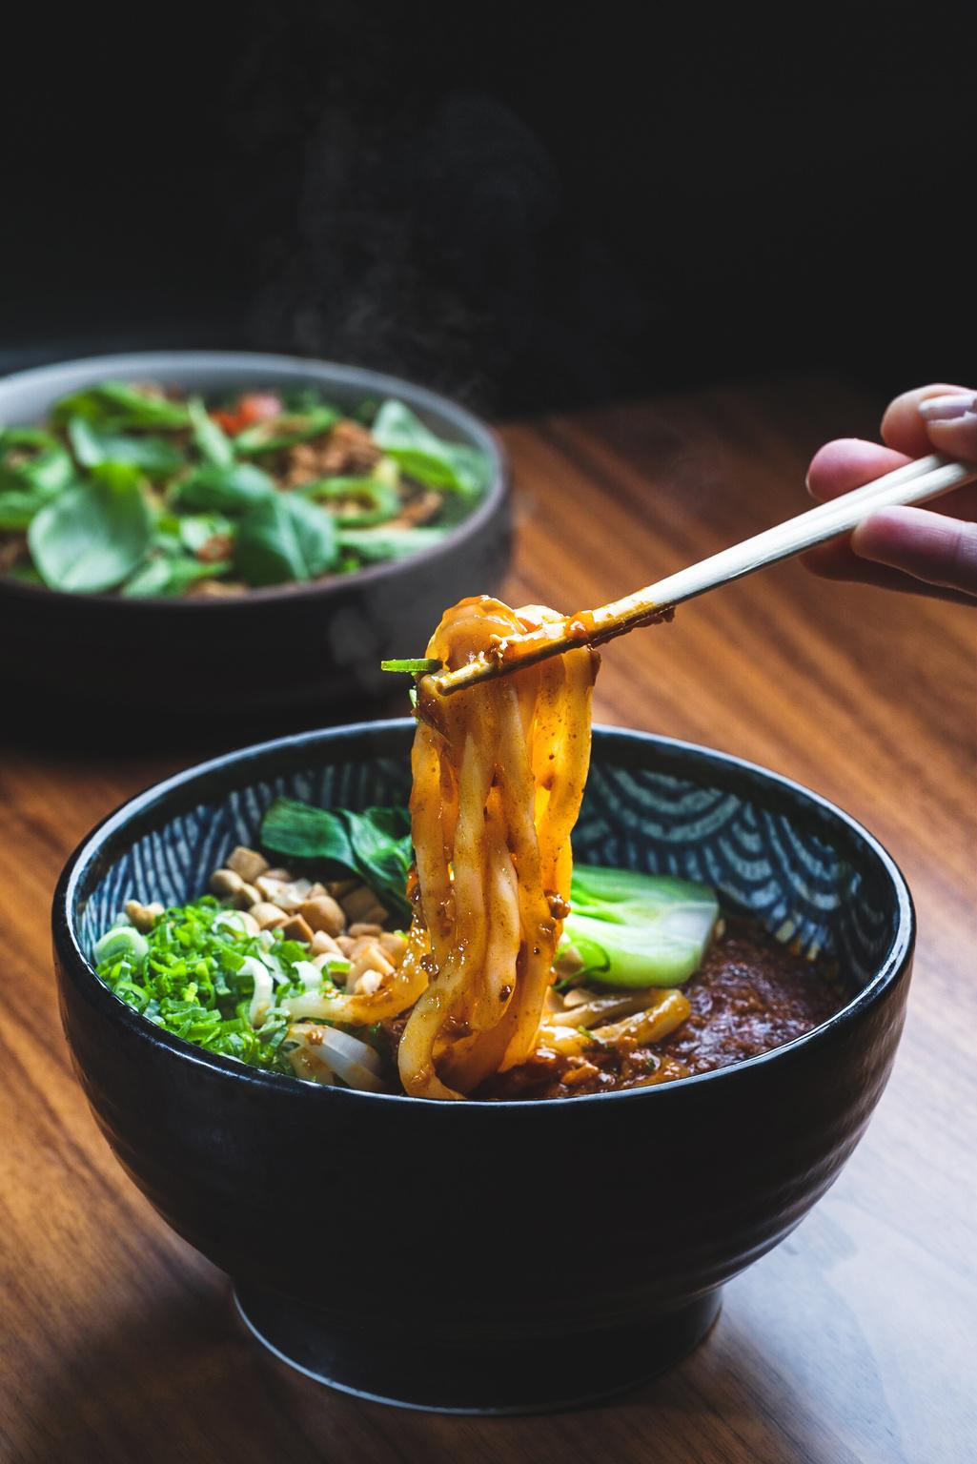

Deep learning-based Food Recipe Generator
Presented By
Tata Lakshmi Durga Likhitha (AP19110010001)
Valavala Mahesh (AP19110010388)
Koliparthi Durgavamsi (AP19110010392)
Godavarthi Venkata Narasamma (AP19110010421)
Supervisor
Dr. Pandu Sowkuntla
Assistant Professor,
Department of Computer Science and Engineering

Slide 2
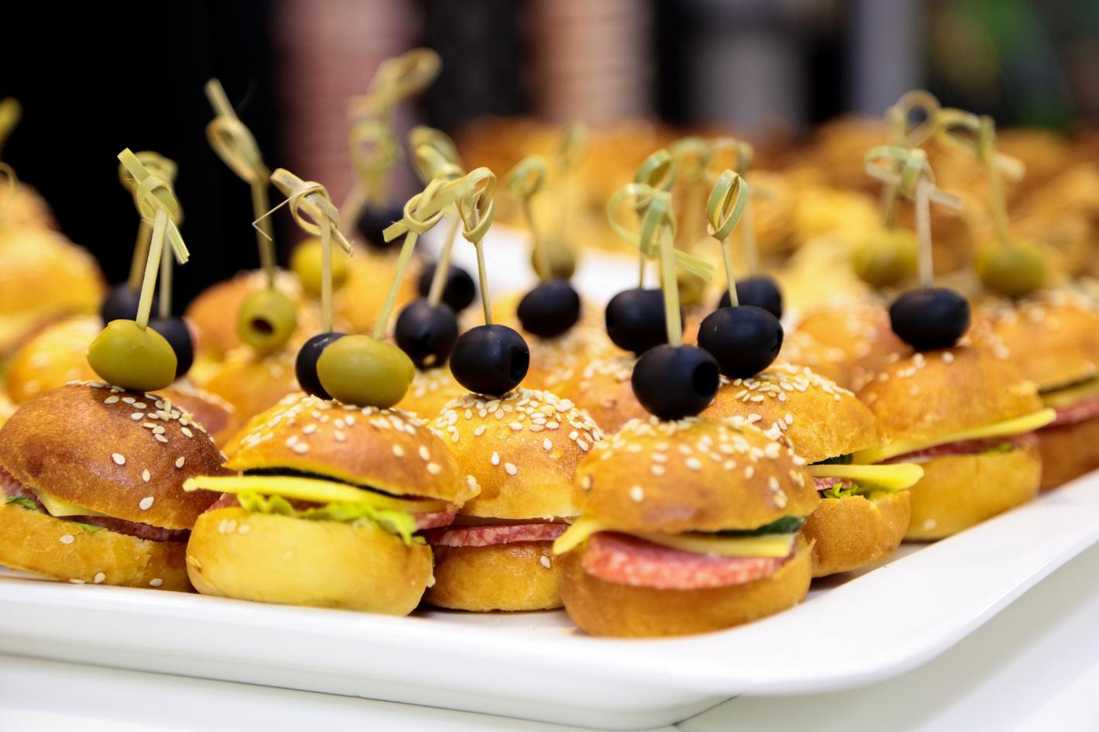
Introduction
Food is not just subsistence; it shapes our culture and influences our well-being.
"We are what we eat" - food directly affects our overall well-being.
The recent corona pandemic situation made us realize many things.

Slide 3
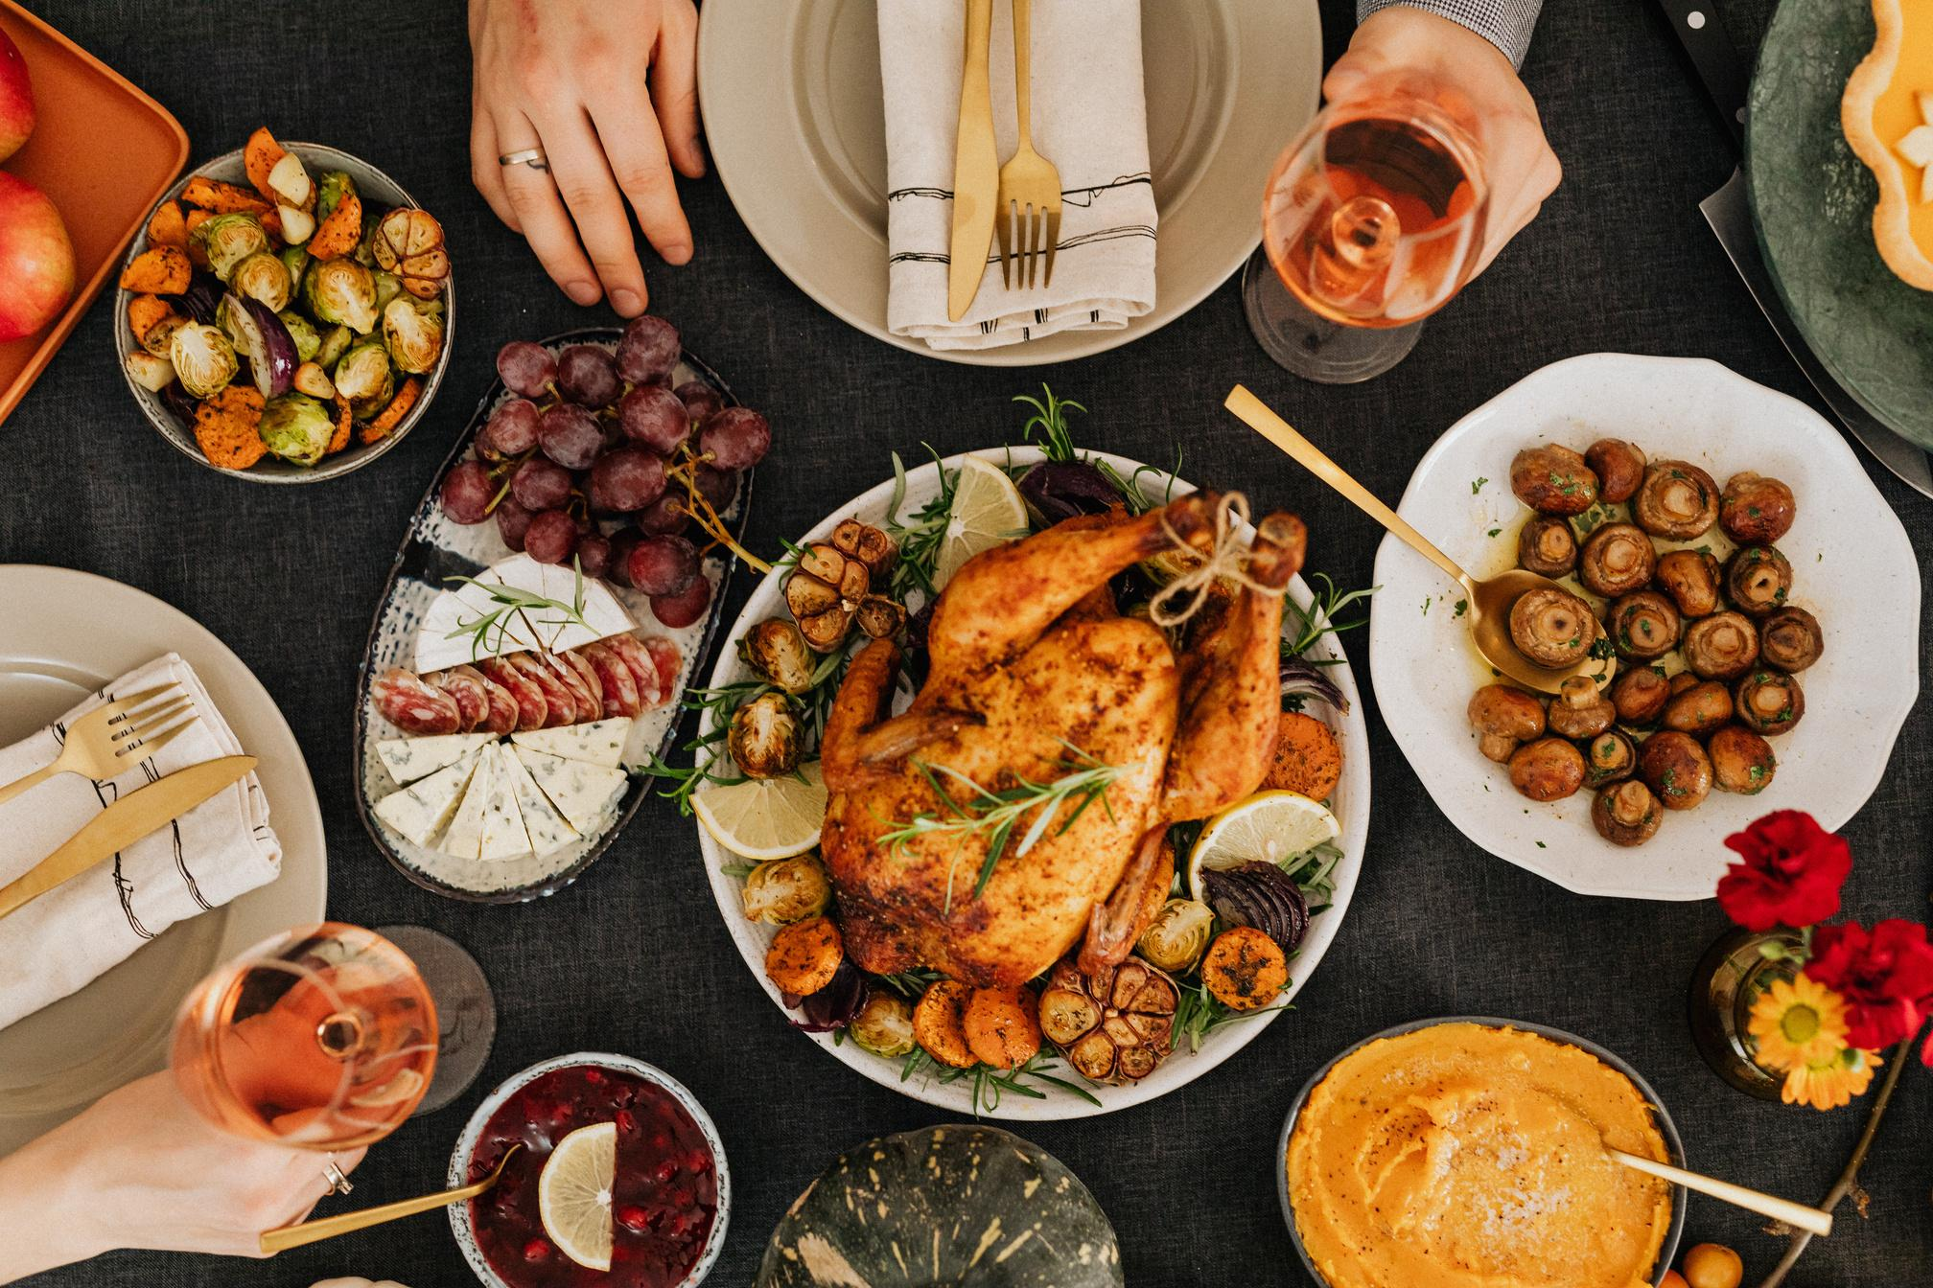
Introduction contd...
There is a need for food recipe generator systems that can infer ingredients and cooking instructions from a prepared meal.
Food recognition poses challenges due to its variability and complex composition.
Overcoming these obstacles require new strategies and innovative techniques.

Slide 4
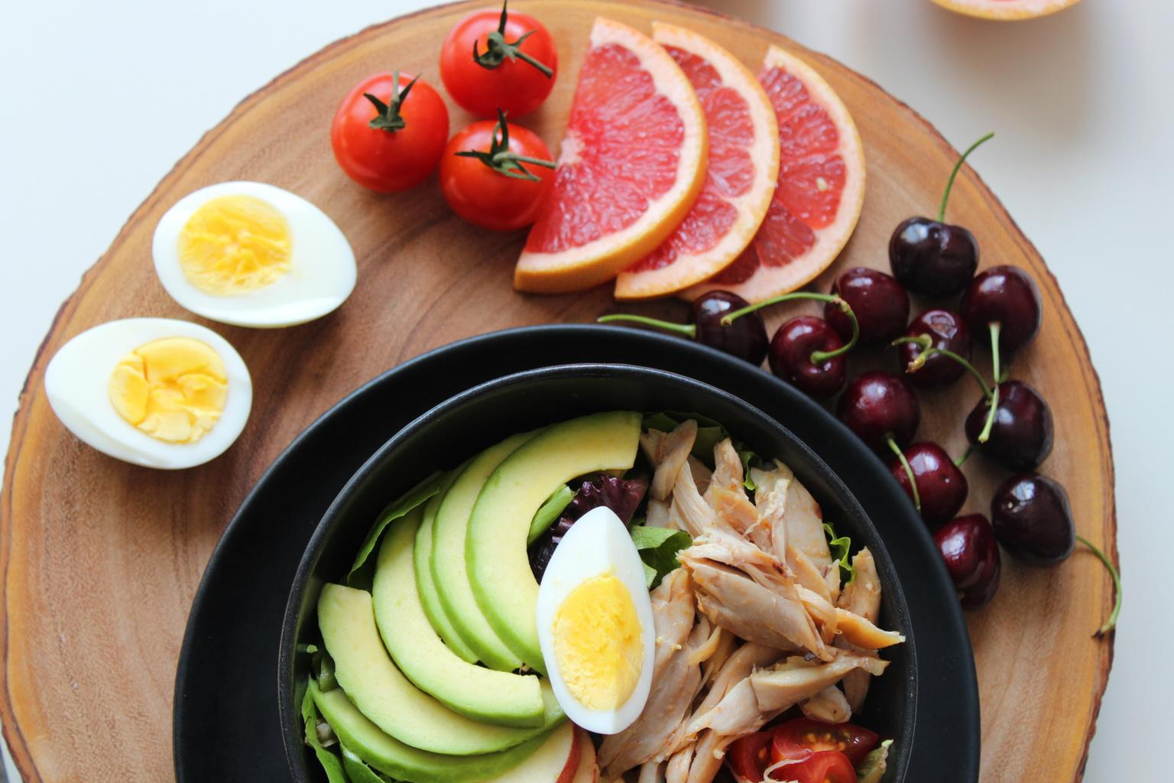
Related works
Food identification focuses on ingredients, and recipes, not preparation methods.
Differentiating dish components and preparation methods is crucial in food identification.
"Sequential Learning for Ingredient Recognition from Images" proposes the identification of ingredients in complex recipes using a combination of CNN, RNN, and LSTM networks.

Slide 5
Related works contd…
Deep learning-based "Large Scale Visual Food Recognition" has been proposed to recognize food in large-scale food images.
The most important drawback that motivated our project is the absence of a comprehensive system that integrates the three components together: ingredient recognition, food identification, and recipe generation.

Slide 6

Proposed Recipe Generator
Motivation
The COVID-19 pandemic has emphasized the importance of home cooking as a means of ensuring food security and minimizing health risks.
Recognizing and understanding food is challenging due to ingredient complexity, variability, and cooking deformations and it requires advanced visual ingredient detection.
These challenges motivated us to propose innovative solution that generates accurate recipes from food images, simplifying home cooking.

Slide 7
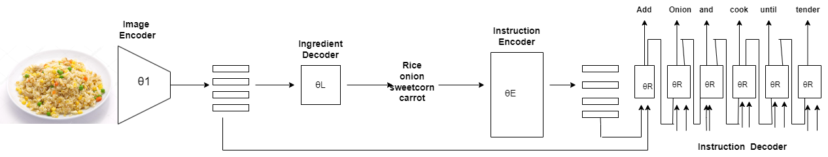
Proposed Recipe Generator contd..
System Architecture

Slide 8
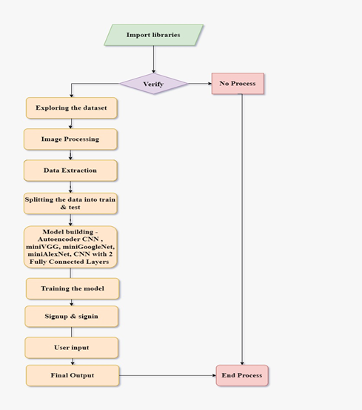
Proposed Recipe Generator contd..
Flow Chart: Recipe Generator
The flow chart shows the execution flow of the proposed recipe generation system.
The proposed system is trained on different CNN models.

Slide 9
Experimental Analysis
Dataset description
The dataset used in the experiments consists of approximately 45k recipes in a tabular format.
The dataset provides essential information such as recipe IDs, names, image URLs,ingredient lists and cooking directions.
The "Images" folder contains a vast collection of approximately 1125 subfolders. Within each subfolder, there are approximately 6 images of the corresponding recipe.

Slide 10
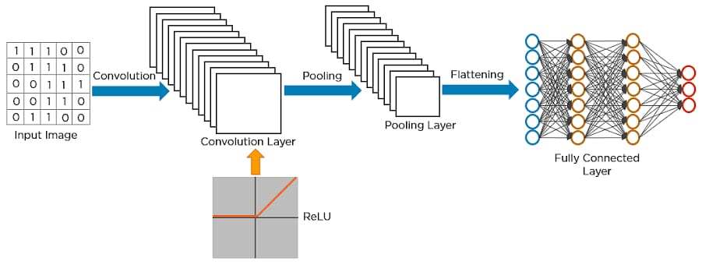
Experimental Analysis contd..
Models used in experiments
CNN
MiniVGG
MiniGoogleNet
MiniAlexNet
CNN with 2 fully
connected layer

Slide 11
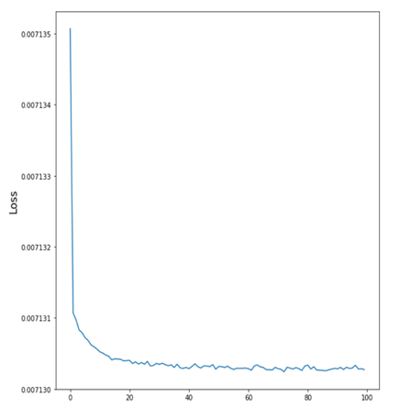
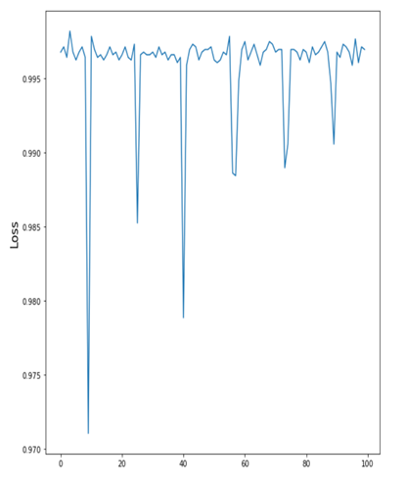
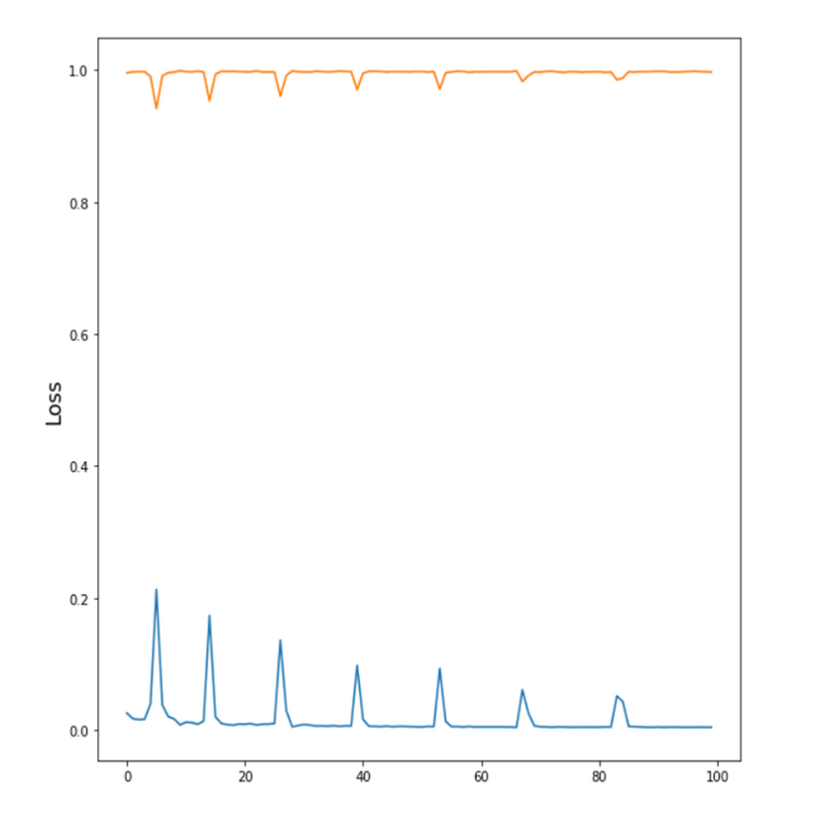
Experimental Analysis contd..
Classification results
CNN - 99.92%
AlexNet - 99.7%
VGG - 99.66%

Slide 12
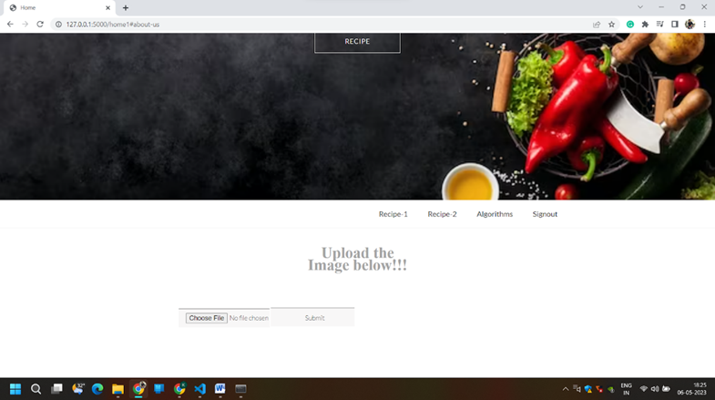
Experimental Analysis contd..
Recipe generation results

Slide 13
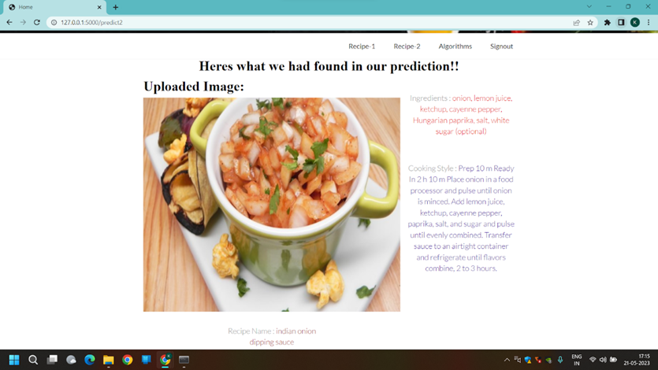

Experimental Analysis contd..
Recipe generation results

Slide 14
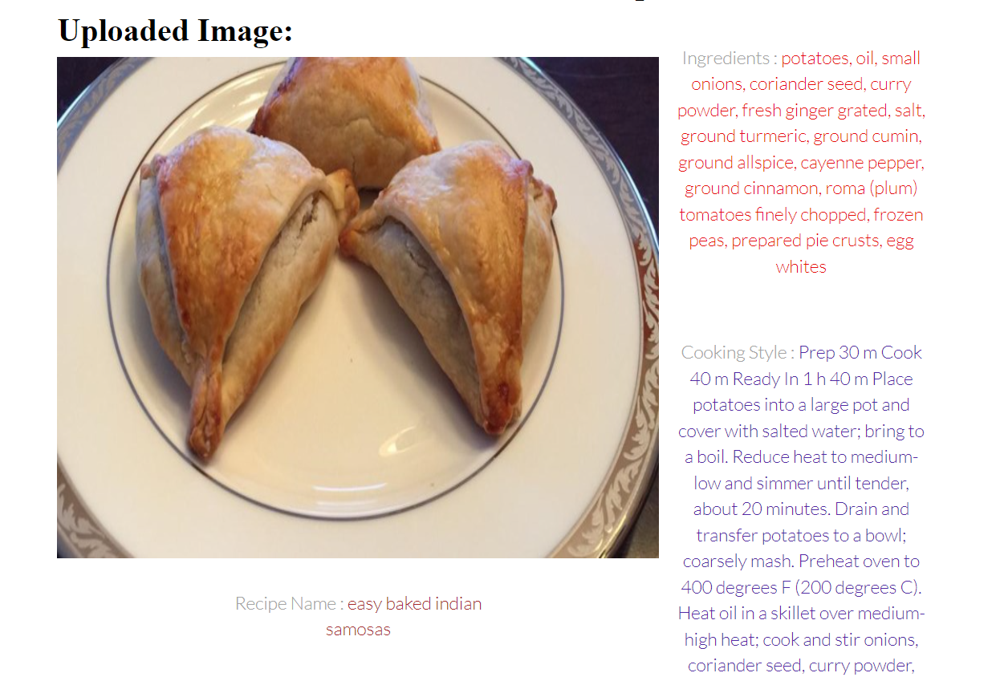
Experimental Analysis contd..
Recipe generation results

Slide 15
Limitations for proposed work
Limited Dataset: Currently, our dataset contains nearly 10,000 food images, which may limit the accuracy and diversity of recipe generation. Expanding the dataset will improve performance.
Voice Integration: Adding voice to the generated recipe introduces potential challenges in transcription and pronunciation accuracy.
Instruction Complexity: The system may face limitations in accuracy for complex cooking techniques, and additional context is required in generated recipe instructions.

Slide 16

Conclusion
Proposed image-to-recipe system: Generates recipes from food images, including title, ingredients, and cooking instructions.
Model comparison: Evaluated accuracy by comparing with other models and selected the most suitable algorithm.
Ingredient and instruction prediction: Initially predicted ingredients, then generated instructions based on images and inferred ingredients.

Slide 17

Future work
In the future, We plan to improve the generated recipe by adding voice functionality.
Additionally, we will expand the dataset, explore various training models, and include reference links, such as videos, to enhance the recipe generation with additional instructions and references.

Slide 18
Refrences
[1]Li, K., & Chen, Y. (2021). DeepRecipes: Exploring Massive Online Recipes and Recovering Food Ingredient Amounts.
Retrieved from https://ieeexplore.ieee.org/stamp/stamp.jsp?arnumber=9423993
[2]H. Wang, G. Lin, S. C. H. Hoi and C. Miao, "Learning Structural Representations for Recipe Generation and Food Retrieval," in IEEE Transactions on Pattern Analysis and Machine Intelligence, vol. 45, no. 3, pp. 3363-3377, 1 March 2023, doi: 10.1109/TPAMI.2022.3181294.
[3] Hassannejad, H., Kiani, M., Salvador, A., & Eirinaki, M. (2021). Large Scale Visual Food Recognition. arXiv preprint arXiv:2103.16107.
A. Salvador, M. Drozdzal, X. Giro-i-Nieto and A. Romero, "Inverse Cooking: Recipe Generation From Food Images," 2019 IEEE/CVF Conference on Computer Vision and Pattern Recognition (CVPR), Long Beach, CA, USA, 2019, pp. 10445-10454, doi: 10.1109/CVPR.2019.01070.

Slide 19
Refrences contd..
[4] M. Zhang, G. Tian, Y. Zhang and H. Liu, "Sequential Learning for Ingredient Recognition From Images," in IEEE Transactions on Circuits and Systems for Video Technology, vol. 33, no. 5, pp. 2162-2175, May 2023, doi: 10.1109/TCSVT.2022.3218790.
[5]M. Zhang, G. Tian, Y. Zhang and H. Liu, "Sequential Learning for Ingredient Recognition From Images," in IEEE Transactions on Circuits and Systems for Video Technology, vol. 33, no. 5, pp. 2162-2175, May 2023, doi: 10.1109/TCSVT.2022.3218790.
[6] Xin Chen, Hua Zhou, and Liang Diao. Chinesefoodnet: A large-scale image dataset for Chinese food recognition. CoRR, abs/1705.02743, 2017. [7] Angela Fan, Mike Lewis, and Yann Dauphin. Hierarchical neural story generation. In ACL, 2018.

Slide 20

Thank You

